Slide 1


CSE3078 – Cryptography and Network Security
School of Computer Science and Engineering

Slide 2
Module 1
Introduction to Cryptography and types of Ciphers

Slide 3
Introduction to Cryptography
Cryptography is the science of writing in secret code and is an ancient art.
Cryptography is the study of secure communications techniques that allow only the sender and intended recipient of a message to view its contents.
Cryptography is not only protects data from theft or alteration, but can also be used for user authentication.
The Crypto term is derived from the Greek word kryptos, which means hidden.
In cryptography, we start with the unencrypted data, referred to as plaintext.
Plaintext is encrypted into ciphertext, which will in turn be decrypted back into usable plaintext.

Slide 4
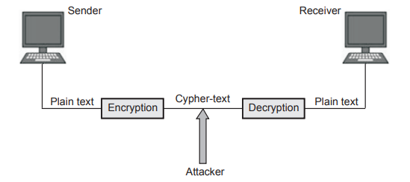
Cryptography

Slide 5
Cryptography provides secure communication in the presence of malicious third parties.
Encryption is the process of encoding a plain text message into non-readable form.
Decryption is a process of converting an encrypted message back into its normal form.
Algorithms are considered secure if an attacker cannot determine any properties of the plaintext or key, given the ciphertext.
An attacker should not be able to determine anything about a key given a large number of plaintext/ciphertext combinations which used the key

Slide 6
Advantages of Cryptography
It provides security to online network communication.
It provides security to email, credit/debit card information etc.
Cryptography hides the contents of a secret message from a malicious people.
Cryptography can also provide authentication for verifying the identity of someone or something.

Slide 7
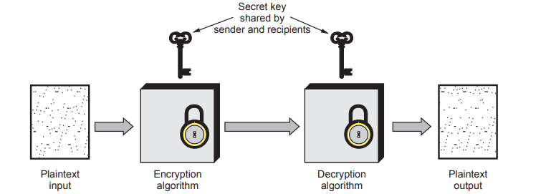
Classical Encryption Techniques
A symmetric encryption model has five ingredients.
Plaintext
Encryption algorithm
Secret key
Ciphertext
Decryption algorithm

Slide 8
Plaintext is the original message or data that is fed into the algorithm as input.
Encryption algorithm performs various substitutions and transformations on the plaintext.
Secret key is a value independent of the plaintext and of the algorithm. The exact substitutions and transformations performed by the algorithm depend on the key.
Ciphertext is the scrambled message produced as output. It depends on the plaintext and the secret key.
Decryption algorithm takes the ciphertext and the secret key and produces the original plaintext.

Slide 9
The Science and art of manipulating messages to make them secure is called cryptography.
The objective is to design an encryption technique so that it would be very difficult or impossible for an unauthorized party to understand the contents of the ciphertext.

Slide 10
Characteristics of cryptography
The type of operations used for transforming plaintext to ciphertext.
The number of keys used.
The way in which the plaintext is processed

Slide 11
Cryptanalysis
The process of trying to break any cipher text message to obtain the original plaintext message itself is called as cryptanalysis.
Cryptanalysis is the breaking of codes.
The person attempting a cryptanalysis is called as a cryptanalyst.
Brute force attack: The attacker tries every possible key on a piece of ciphertext until an intelligible translation into plaintext is obtained.

Slide 12
Model of Network Security
A message is to be transferred from one party to another across some sort of Internet service.
The two parties, who are the principals in this transaction, must cooperate for the exchange to take place.
A logical information channel is established by defining a route through the Internet from source to destination and by the cooperative use of communication protocols (e.g., TCP/IP) by the two principals.

Slide 13
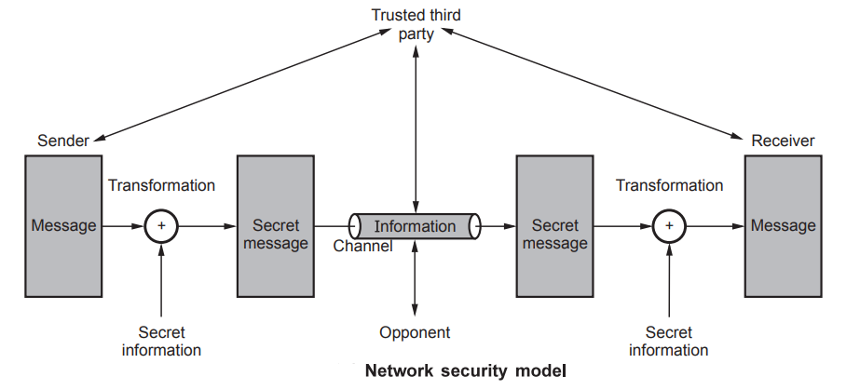

Slide 14
Security aspects come into play when it is necessary or desirable to protect the information transmission from an opponent who may present a threat to confidentiality, authenticity, and so on. All the techniques for providing security have two components:
A security-related transformation on the information to be sent. Examples include the encryption of the message, which scrambles the message so that it is unreadable by the opponent, and the addition of a code based on the contents of the message, which can be used to verify the identity of the sender.

Slide 15
Some secret information shared by the two principals and, it is hoped, unknown to the opponent.
An example is an encryption key used in conjunction with the transformation to scramble the message before transmission and unscramble it on reception.
A trusted third party may be needed to achieve secure transmission.
For example, a third party may be responsible for distributing the secret information to the two principals while keeping it from any opponent.

Slide 16
This general model shows that there are four basic tasks in designing a particular security service:
Design an algorithm for performing the security-related transformation. The algorithm should be such that an opponent cannot defeat its purpose.
Generate the secret information to be used with the algorithm.
Develop methods for the distribution and sharing of the secret information.
Specify a protocol to be used by the two principals that makes use of the security algorithm and the secret information to achieve a particular security service.

Slide 17
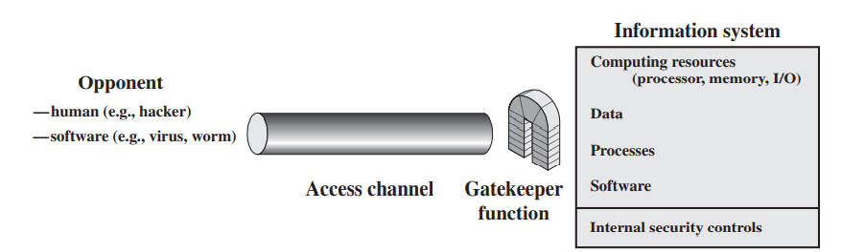
Network Access Security Model

Slide 18
To protecting an information system from unwanted access.
The hacker can be someone who, with no negative intent, simply gets satisfaction from breaking and entering a computer system.
The intruder can be a unhappy employee who wishes to do damage or a criminal who seeks to exploit computer assets for financial gain (e.g., obtaining credit card numbers or performing illegal money transfers).

Slide 19
Another type of unwanted access is the placement in a computer system of logic that exploits vulnerabilities in the system and that can affect application programs as well as utility programs, such as editors and compilers

Slide 20
Programs can present two kinds of threats:
Information access threats: Intercept or modify data on behalf of users who should not have access to that data.
Service threats: Exploit service flaws in computers to inhibit use by legitimate users.

Slide 21
The security mechanisms needed to cope with unwanted access fall into two broad categories.
The first category might be termed a gatekeeper function.
It includes password-based login procedures that are designed to deny access to all but authorized users and screening logic that is designed to detect and reject worms, viruses, and other similar attacks.

Slide 22
Once either an unwanted user or unwanted software gains access, the second line of defense consists of a variety of internal controls that monitor activity and analyze stored information in an attempt to detect the presence of unwanted intruders.

Slide 23
OSI Security Architecture
The OSI security architecture is useful to managers as a way of organizing the task of providing security.
ITU-T4 Recommendation X.800 security architecture for OSI defines such a systematic approach.
The OSI security architecture focuses on security attacks, mechanisms and services.

Slide 24
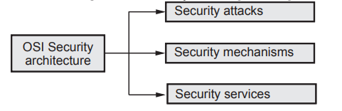
Security attack: Any action that compromises the security of information owned by an organization.
Security mechanism: A process that is designed to detect, prevent or recover from a security attack.
Security service: A processing or communication service that enhances the security of the data processing systems and the information transfers of an organization.

Slide 25
Security Attack
Computer based systems have three valuable components: Hardware, Software and data.
Securities of these components are evaluated in terms of vulnerability, threats, attacks and control.
An assault on system security that derives from an intelligent threat; that is, an intelligent act that is a deliberate attempt to evade security services and violate the security policy of a system.

Slide 26
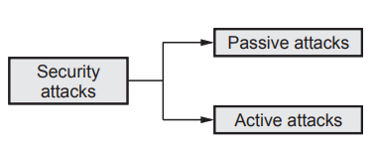
Types of Security Attacks
An attempt to gain unauthorized access to information resource or services, or to cause harm or damage to information systems.
Security attacks are of two types:
Passive attack
Active attack

Slide 27
Passive Attack
A passive attack attempts to learn or make use of information from the system but does not affect system resources.
The attacker aims to obtain information that is in transit.
The term passive indicates that the attacker does not attempt to perform any modification to the data.
Passive attacks are of two types:
Release of message contents
Traffic analysis

Slide 28
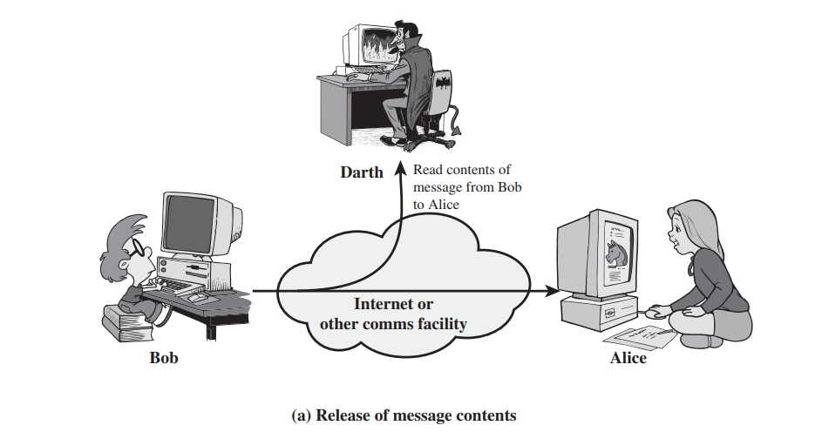
Release of message content
A telephone conversation, an electronic mail message, and a transferred file may contain sensitive or confidential information.
To prevent an opponent from learning the contents of these transmissions

Slide 29
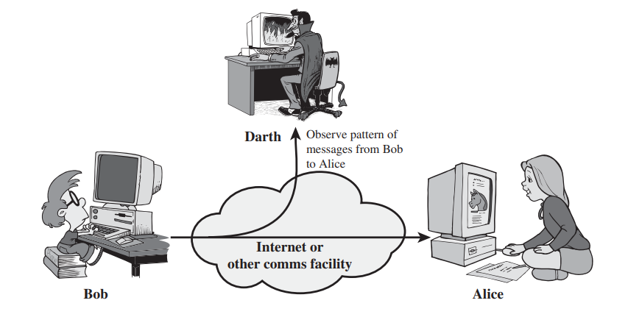
Traffic analysis
Suppose that we had a way of masking (encryption) information, so that the attacker even if captured the message could not extract any information from the message.
The opponent could determine the location and identity of communicating host and could observe the frequency and length of messages being exchanged.
This information might be useful in guessing the nature of the communication that was taking place.

Slide 30
Active Attacks
Active attacks involve some modification of the data stream or the creation of a false stream and can be subdivided into four categories: masquerade, replay, modification of messages, and denial of service

Slide 31
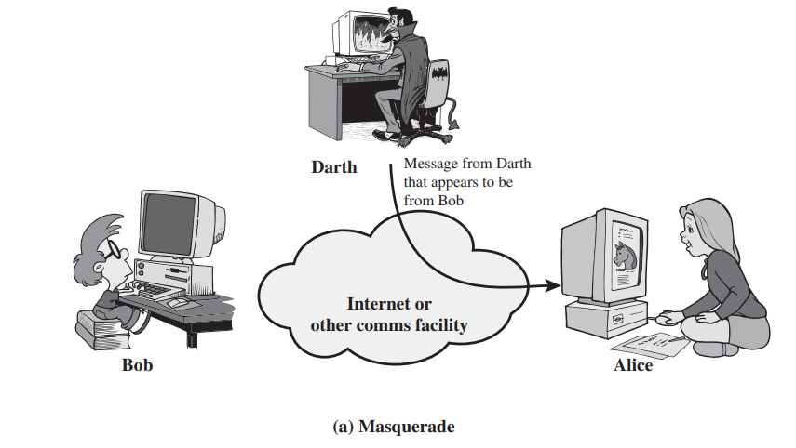
Masquerade
A masquerade takes place when one entity pretends to be a different entity.
A masquerade attack usually includes one of the other forms of active attack.
For example, authentication sequences can be captured and replayed after a valid authentication sequence has taken place, thus enabling an authorized entity with few privileges to obtain extra privileges by impersonating an entity that has those privileges

Slide 32
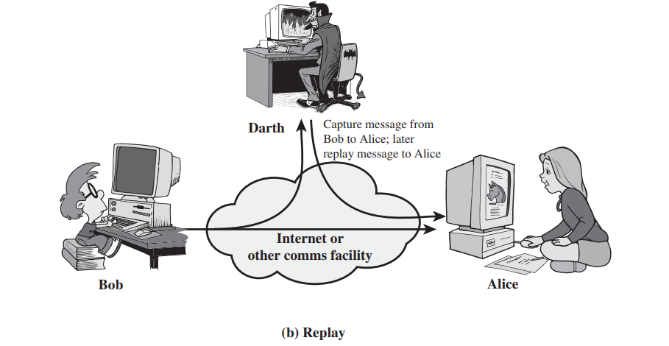
Replay
Replay involves the passive capture of a data unit and its subsequent retransmission to produce an unauthorized effect

Slide 33
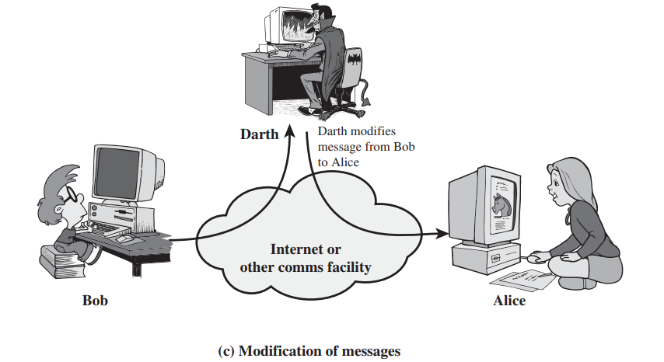
Modification of messages
Modification of messages simply means that some portion of a legitimate message is altered, or that messages are delayed or reordered, to produce an unauthorized effect.
For example, a message meaning “Allow John Smith to read confidential file accounts” is modified to mean “Allow Fred Brown to read confidential file accounts.”

Slide 34
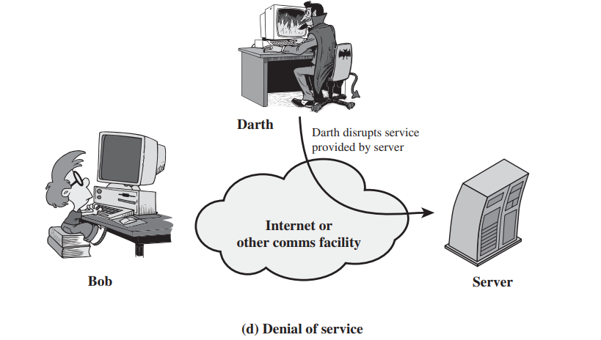
Denial of service
The denial of service prevents or inhibits the normal use or management of communications facilities.
This attack may have a specific target; for example, an entity may suppress all messages directed to a particular destination e.g., (the security audit service).
Another form of service denial is the disruption of an entire network, either by disabling the network or by overloading it with messages so as to degrade performance

Slide 35
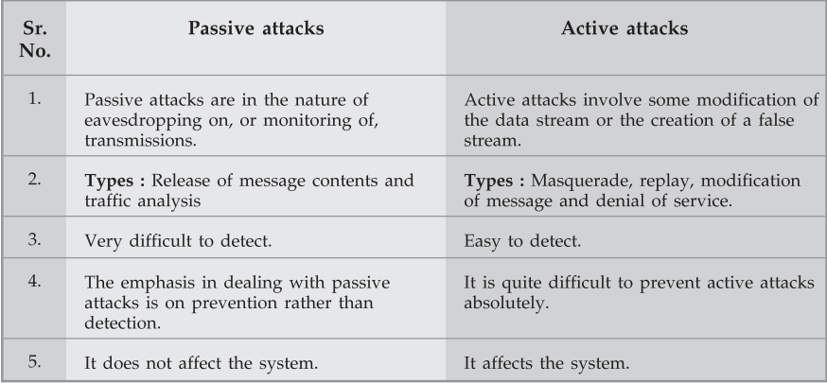
Difference between Passive and Active attacks

Slide 36
Security Service
A processing or communication service that enhances the security of the data processing systems and the information transfers of an organization.
The services are intended to counter security attacks, and they make use of one or more security mechanisms to provide the service.

Slide 37
Security Services
X.800:
“a service provided by a protocol layer of communicating open systems, which ensures adequate security of the systems or of data transfers”
RFC 2828:
“a processing or communication service provided by a system to give a specific kind of protection to system resources”

Slide 38
Security Services (X.800)
Authentication - assurance that the communicating entity is the one claims to be
Peer Entity Authentication Used in association with a logical connection to provide confidence in the identity of the entities connected.
Data-Origin Authentication In a connectionless transfer, provides assurance that the source of received data is as claimed.

Slide 39
Access Control
Access Control - The prevention of unauthorized use of a resource (i.e., this service controls who can have access to a resource, under what conditions access can occur, and what those accessing the resource are allowed to do).

Slide 40
Data Confidentiality –The protection of data from unauthorized disclosure.
Connection Confidentiality The protection of all user data on a connection.
Connectionless Confidentiality The protection of all user data in a single data block
Selective-Field Confidentiality The confidentiality of selected fields within the user data on a connection or in a single data block.
Traffic-Flow Confidentiality The protection of the information that might be derived from observation of traffic flows

Slide 41
Data Integrity
Data Integrity - The assurance that data received are exactly as sent by an authorized entity (i.e., contain no modification, insertion, deletion, or replay).
Connection Integrity with Recovery Provides for the integrity of all user data on a connection and detects any modification, insertion, deletion, or replay of any data within an entire data sequence, with recovery attempted.

Slide 42
Connection Integrity without Recovery As above, but provides only detection without recovery.
Selective-Field Connection Integrity Provides for the integrity of selected fields within the user data of a data block transferred over a connection and takes the form of determination of whether the selected fields have been modified, inserted, deleted, or replayed.

Slide 43
Non-Repudiation
Provides protection against denial by one of the entities involved in a communication of having participated in all or part of the communication.
Nonrepudiation, Origin Proof that the message was sent by the specified party.
Nonrepudiation, Destination Proof that the message was received by the specified party

Slide 44
Security Mechanism
A process (or a device incorporating such a process) that is designed to detect, prevent, or recover from a security attack.
Specific Security Mechanisms
Pervasive Security Mechanisms

Slide 45
Specific Security Mechanisms
May be incorporated into the appropriate protocol layer in order to provide some of the OSI security services
Encipherment The use of mathematical algorithms to transform data into a form that is not readily intelligible. The transformation and subsequent recovery of the data depend on an algorithm and zero or more encryption keys.
Digital Signature Data appended to, or a cryptographic transformation of, a data unit that allows a recipient of the data unit to prove the source and integrity of the data unit and protect against forgery (e.g., by the recipient).
Access Control A variety of mechanisms that enforce access rights to resources.
Data Integrity A variety of mechanisms used to assure the integrity of a data unit or stream of data units

Slide 46
Authentication Exchange A mechanism intended to ensure the identity of an entity by means of information exchange.
Traffic Padding The insertion of bits into gaps in a data stream to frustrate traffic analysis attempts.
Routing Control Enables selection of particular physically secure routes for certain data and allows routing changes, especially when a breach of security is suspected.
Notarization The use of a trusted third party to assure certain properties of a data exchange.

Slide 47
Pervasive Security Mechanisms
Mechanisms that are not specific to any particular OSI security service or protocol layer.
Trusted Functionality That which is perceived to be correct with respect to some criteria (e.g., as established by a security policy).
Security Label The marking bound to a resource (which may be a data unit) that names or designates the security attributes of that resource

Slide 48
Event Detection Detection of security-relevant events.
Security Audit Trail Data collected and potentially used to facilitate a security audit, which is an independent review and examination of system records and activities.
Security Recovery Deals with requests from mechanisms, such as event handling and management functions, and takes recovery actions

Slide 49
Classical Substitution Ciphers
where letters of plaintext are replaced by other letters or by numbers or symbols
or if plaintext is viewed as a sequence of bits, then substitution involves replacing plaintext bit patterns with ciphertext bit patterns

Slide 50
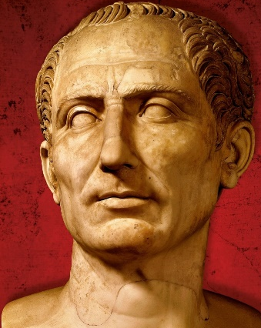
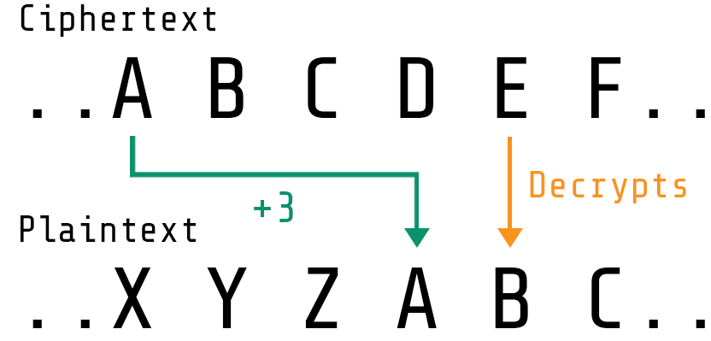
Classical Substitution - Caesar Cipher
Earliest and simplest was by Julius Caesar.
Primarily used in warfare.
Involves replacing each letter of the alphabet with the letter standing three places further down the alphabet.
This cipher replaces each letter by n^{th} letter down the alphabet.
Example:
Plain text:
MEET ME AFTER THE PARTY
Cipher text:
PHHW PH DIWHU WKH SDUWB

Slide 51
Classical Substitution - Caesar Cipher - Mathematically
How it works?
Alphabet is wrapped around ,so that the letter following Z is A.
Assign a numerical equivalent to each letter as follows :
A = 0
B = 1
C = 2
Z = 25
For each plaintext letter P, substitute for cipher text C as :
C = (P + 3) mod 26
A shift may be of any amount, so that in general Caesar algorithm is:
C = (P + K ) mod 26 where k is any value from 1 to 25.
The decryption algorithm is given by:
P = (C - K) mod 26
https://crypto.interactive-maths.com/caesar-shift-cipher.html

Slide 52
Caesar Cipher
can define transformation as:
a b c d e f g h i j k l m n o p q r s t u v w x y z
D E F G H I J K L M N O P Q R S T U V W X Y Z A B C
mathematically give each letter a number
a b c d e f g h i j k l m n o p q r s t u v w x y z
0 1 2 3 4 5 6 7 8 9 10 11 12 13 14 15 16 17 18 19 20 21 22 23 24 25
then have Caesar cipher as:
c = E(p) = (p + k) mod (26)
p = D(c) = (c – k) mod (26)

Slide 53
Cryptanalysis of Caesar Cipher
only have 26 possible ciphers
A maps to A,B,..Z
could simply try each in turn
a brute force search
given ciphertext, just try all shifts of letters
do need to recognize when have plaintext
eg. break ciphertext "GCUB VQ DTGCM"

Slide 54
Monoalphabetic Cipher
rather than just shifting the alphabet
could shuffle (jumble) the letters arbitrarily
each plaintext letter maps to a different random ciphertext letter
hence key is 26 letters long
Plain: abcdefghijklmnopqrstuvwxyz
Cipher: DKVQFIBJWPESCXHTMYAUOLRGZN
Plaintext: ifwewishtoreplaceletters
Ciphertext: WIRFRWAJUHYFTSDVFSFUUFYA

Slide 55
Monoalphabetic Cipher Security
now have a total of 26! = 4 x 1026 keys
with so many keys, might think is secure
but would be !!!WRONG!!!
problem is language characteristics

Slide 56
Language Redundancy and Cryptanalysis
human languages are redundant
eg "th lrd s m shphrd shll nt wnt"
letters are not equally commonly used
in English E is by far the most common letter
followed by T,R,N,I,O,A,S
other letters like Z,J,K,Q,X are fairly rare
have tables of single, double & triple letter frequencies for various languages

Slide 57
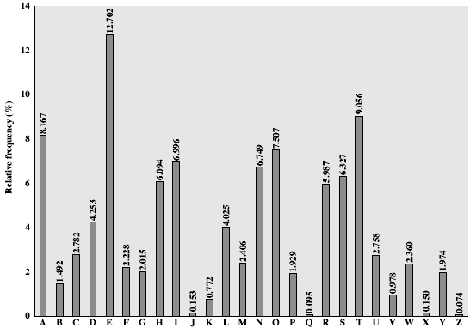
English Letter Frequencies

Slide 58
Use in Cryptanalysis
key concept - monoalphabetic substitution ciphers do not change relative letter frequencies
discovered by Arabian scientists in 9th century
calculate letter frequencies for ciphertext
compare counts/plots against known values
if caesar cipher look for common peaks/troughs
peaks at: A-E-I triple, NO pair, RST triple
troughs at: JK, X-Z
for monoalphabetic must identify each letter
tables of common double/triple letters help

Slide 59
Example Cryptanalysis
given ciphertext:
UZQSOVUOHXMOPVGPOZPEVSGZWSZOPFPESXUDBMETSXAIZ
VUEPHZHMDZSHZOWSFPAPPDTSVPQUZWYMXUZUHSX
EPYEPOPDZSZUFPOMBZWPFUPZHMDJUDTMOHMQ
count relative letter frequencies (see text)
guess P & Z are e and t
guess ZW is th and hence ZWP is the
proceeding with trial and error finally get:
it was disclosed yesterday that several informal but
direct contacts have been made with political
representatives of the viet cong in moscow

Slide 60
Hill Cipher
Hill Cipher was invented and developed in 1929 by Lester S. Hill.
The Hill cipher is an example of a block cipher.
A block cipher is a cipher in which groups of letters are enciphered together in equal length blocks .
The Hill cipher is a polygraphic substitution cipher built on concepts from Linear Algebra.
Key is represented in form of matrix (2 x2 or 3x3 , etc..)
(Note: Determinate of Key matrix must be non-zero)
Each letter is represented by number 0 to 25 and calculation are based on mod 26.
The Hill cipher makes use of modulo arithmetic, matrix multiplication, and matrix inverses; hence, it is a more mathematical cipher than others

Slide 61
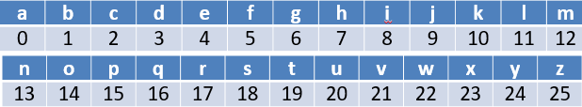
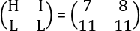
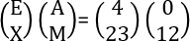
Hill Cipher - Encryption
Encrypting with the Hill cipher is built on the following operation:
C = (K*P) mod 26
Where K is our key matrix and P is the plaintext in vector form.
Matrix multiplying these two terms produces the encrypted ciphertext.
Example: Key= HILL
Plaintext=exam
Key Matrix=
Plain Text =

Slide 62
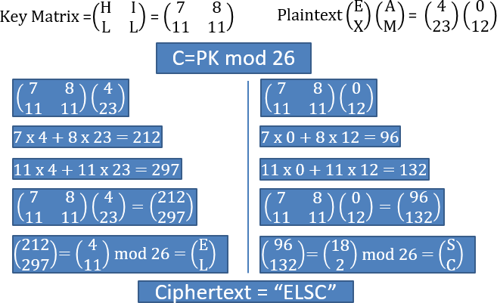

Slide 63
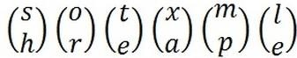
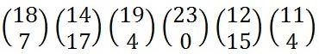
Hill Cipher – Encryption
Example-2
Encrypting with the Hill cipher is built on the following operation:
C = (K*P) mod 26
Where K is our key matrix and P is the plaintext in vector form.
Matrix multiplying these two terms produces the encrypted ciphertext.
Example:
Key= HILL
Plaintext=short example
Key Matrix=
Plain Text:
=

Slide 64
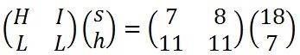
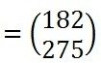
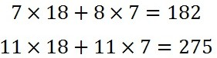
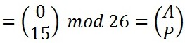
Hill Cipher – Encryption
Example-2
How to find 275 mod 26?
=275/26
=10.5769
10.5769-10
0.5769x26=15
ciphertext = "APADJ TFTWLFJ".

Slide 65
Hill Cipher – Encryption
Example-2
ciphertext = "APADJ TFTWLFJ".

Slide 66
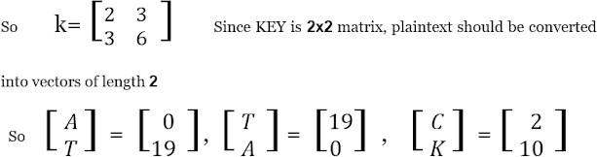
Hill Cipher – Encryption
Example-3
Example:
Key= CDDG
Plaintext=ATTACK

Slide 67
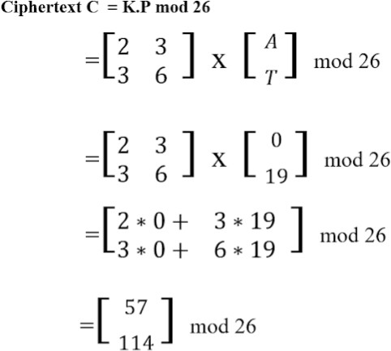
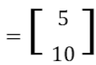
Hill Cipher – Encryption
Example-3

Slide 68
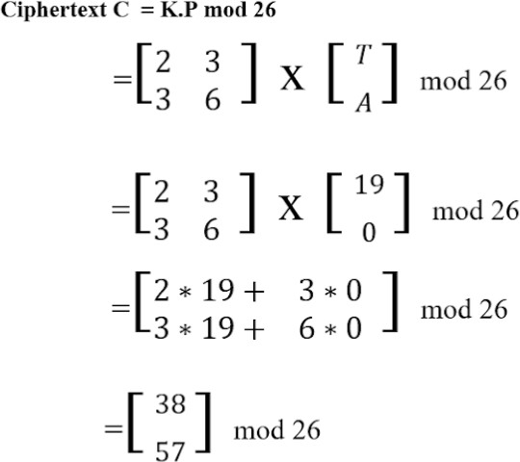
Hill Cipher – Encryption
Example-3

Slide 69
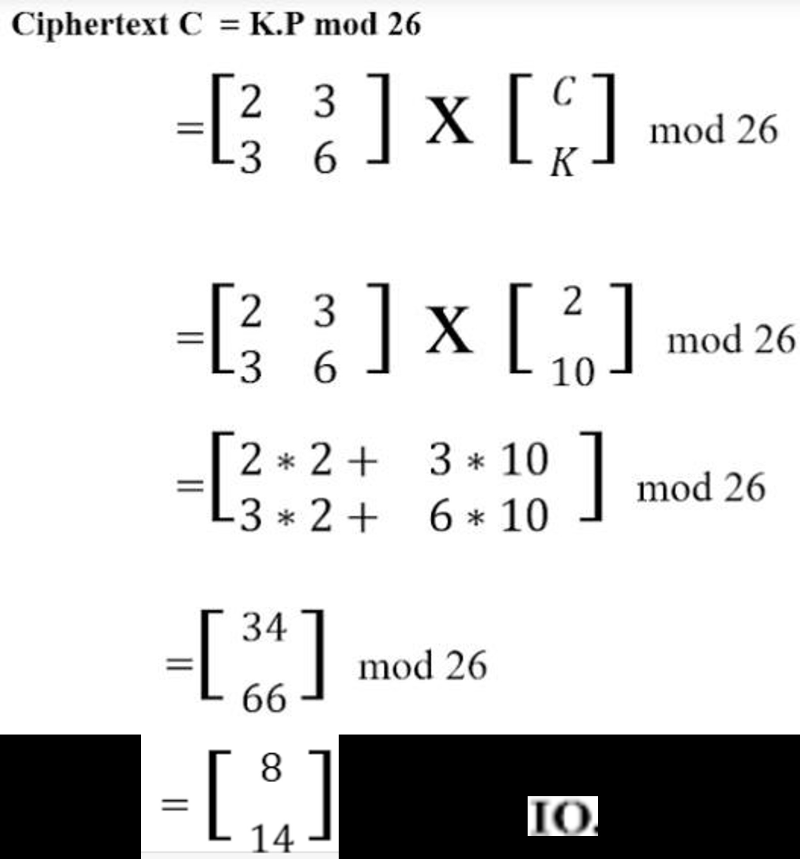
Hill Cipher – Encryption
Example-3

Slide 70
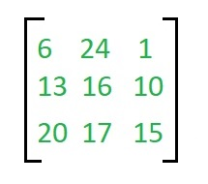
Hill Cipher – Encryption
To encrypt the message ‘ACT’ (n=3).The key is ‘GYBNQKURP’ which can be written as the nxn matrix:

Slide 71
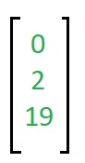
The message ‘ACT’ is written as vector:

Slide 72
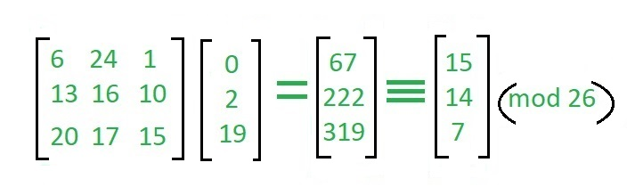
The enciphered vector is given as
which corresponds to ciphertext of ‘POH’

Slide 73
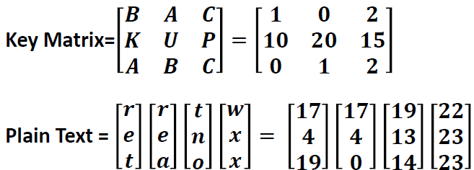
Hill Cipher – Encryption
Encrypting with the Hill cipher is built on the following operation:
C = (K*P) mod 26
Where K is our key matrix and P is the plaintext in vector form.
Matrix multiplying these two terms produces the encrypted ciphertext.
Example:
Key= BKAAUBCPC
Plaintext= retreat now

Slide 74

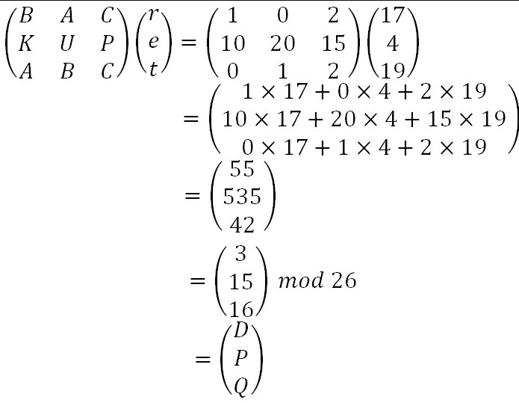
Hill Cipher
Encryption
C= P*K mod 26

Slide 75
Hill Cipher
Encryption
C= P*K mod 26

Slide 76

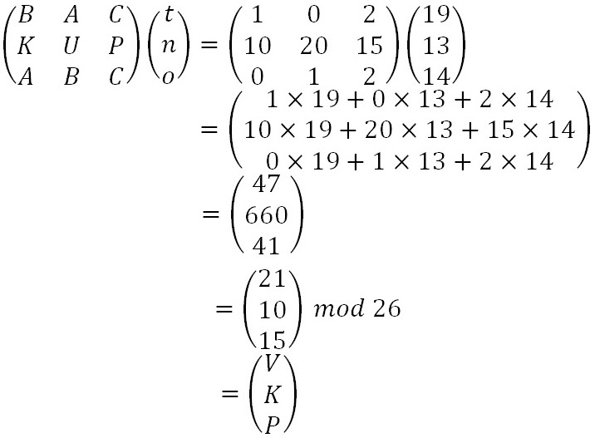
Hill Cipher
Encryption
C= P*K mod 26

Slide 77

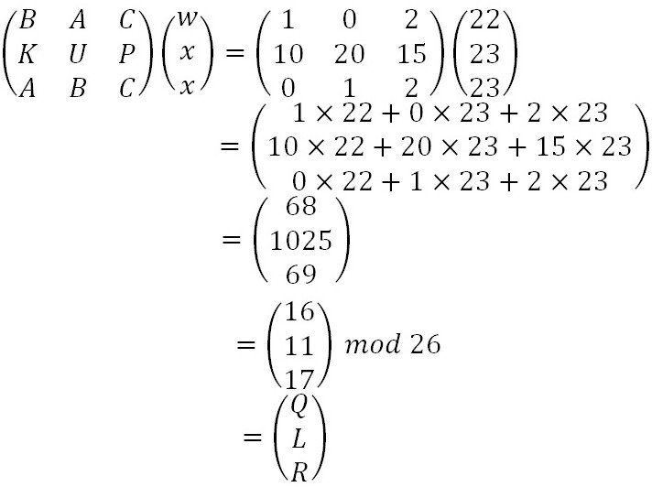
Hill Cipher
Encryption
C= P*K mod 26

Slide 78
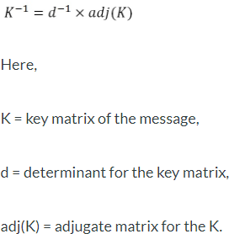
Hill Cipher
Decryption
P= C⁻¹*K mod 26

Slide 79
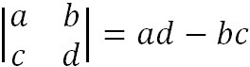
Hill Cipher – Decryption: Example 2x2 Key matrix
Step 1: Calculate the multiplicative inverse for the determinant.
1.1 Find Determinate of the Matrix
Key Matrix =
D=15

Slide 80
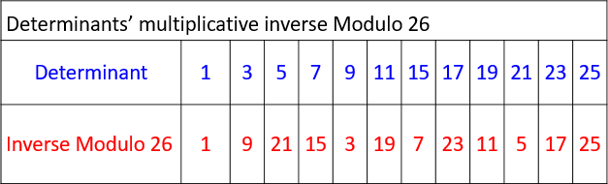
Hill Cipher – Decryption: Example 2x2 Key matrix
Step 2: Calculate the multiplicative inverse for the determinant.
1.2 Find multiplicative inverse of Determinate of the Matrix
_{dd}-1
≡ 1 mod 26
d * d⁻¹ mod 26 =1
= 15 * d⁻¹ mod 26 =1 (Hit and trial Method)
If d⁻¹ = 7 then 15*7 mod 26 = 105 mod 26 = 1
hence d⁻¹ =7

Slide 81
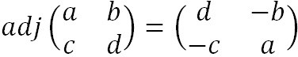
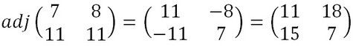
Hill Cipher – Decryption: Example 2x2 Key matrix
Step 2: Multiply multiplicative inverse of the determinant with adjoint matrix
2.1 Calculate Adjoint matrix
And for negative values, we have to add them with 26 to get the desired values between 0 and 25 for use in the decryption formula.

Slide 82
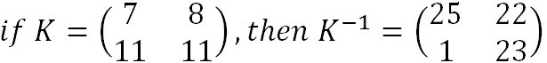
Hill Cipher – Decryption: Example 2x2 Key matrix
Step 2: Multiply multiplicative inverse of the determinant with adjoint matrix
2.2 Multiply d-1 with Adjoin matrix

Slide 83
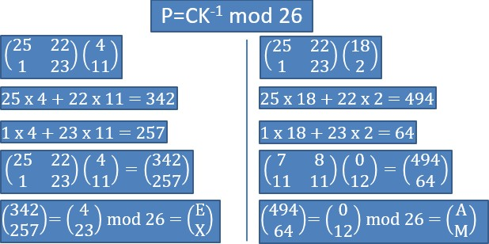
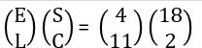
Hill Cipher – Decryption: Example 2x2 Key matrix
Step 3: Multiply inverse key matrix with Cipher text matrix to obtain plaintext
ciphertext as
‘ELSC’

Slide 84

Hill Cipher Decryption: Example 2
Key: HILL
Ciphertext: APADJ TFTWLFJ
Step 1: Calculate the multiplicative inverse for the determinant.
Step 2: Multiply it with Adjoin matrix
Step 3: Multiple inverse key matrix with Cipher text matrix to obtain plaintext

Slide 85
Hill Cipher – Decryption: Example 2x2 Key matrix
Step 1: Calculate the multiplicative inverse for the determinant.
1.1 Find Determinate of the Matrix
Key Matrix =
D=15

Slide 86
Hill Cipher – Decryption: Example 2x2 Key matrix
Step 2: Calculate the multiplicative inverse for the determinant.
1.2 Find multiplicative inverse of Determinate of the Matrix
_{dd}-1
≡ 1 mod 26
d * d⁻¹ mod 26 =1
= 15 * d⁻¹ mod 26 =1 (Hit and trial Method)
If d⁻¹ = 7 then 15*7 mod 26 = 105 mod 26 = 1
hence d⁻¹ =7

Slide 87
Hill Cipher – Decryption: Example 2x2 Key matrix
Step 2: Multiply multiplicative inverse of the determinant with adjoint matrix
2.1 Calculate Adjoint matrix
And for negative values, we have to add them with 26 to get the desired values between 0 and 25 for use in the decryption formula.

Slide 88
Hill Cipher – Decryption: Example 2x2 Key matrix
Step 2: Multiply multiplicative inverse of the determinant with adjoint matrix
2.2 Multiply d-1 with Adjoin matrix

Slide 89
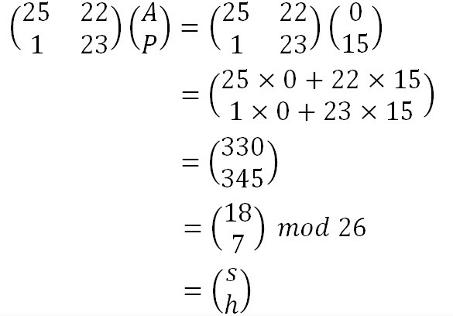
Hill Cipher – Decryption: Example 2x2 Key matrix
Step 3: Multiple inverse key matrix with Cipher text matrix to obtain plaintext
ciphertext as ‘APADJ TFTWLFJ’

Slide 90
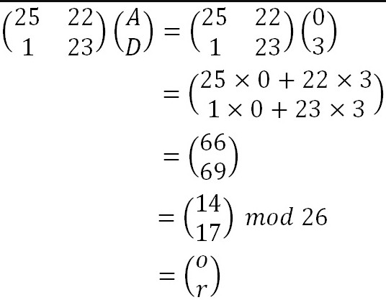
Hill Cipher – Decryption: Example 2x2 Key matrix
Step 3: Multiple inverse key matrix with Cipher text matrix to obtain plaintext
ciphertext as ‘APADJ TFTWLFJ’

Slide 91
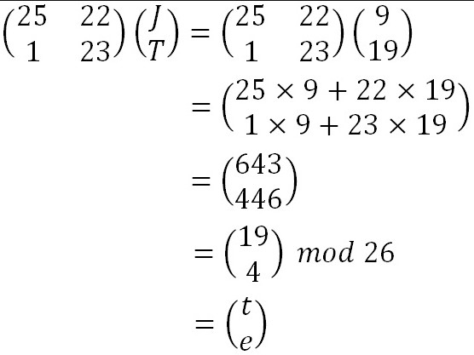
Hill Cipher – Decryption: Example 2x2 Key matrix
Step 3: Multiple inverse key matrix with Cipher text matrix to obtain plaintext
ciphertext as ‘APADJ TFTWLFJ’

Slide 92
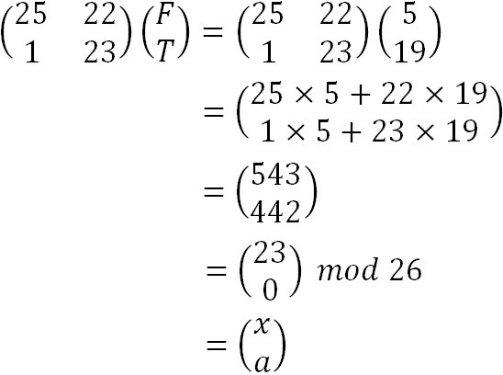
Hill Cipher – Decryption: Example 2x2 Key matrix
Step 3: Multiple inverse key matrix with Cipher text matrix to obtain plaintext
ciphertext as
‘APADJ TFTWLFJ’

Slide 93

Hill Cipher – Decryption: Example 2x2 Key matrix
Step 3: Multiple inverse key matrix with Cipher text matrix to obtain plaintext
ciphertext as
‘APADJ TFTWLFJ’

Slide 94

Hill Cipher – Decryption: Example 2x2 Key matrix
Step 3: Multiple inverse key matrix with Cipher text matrix to obtain plaintext
ciphertext as
‘APADJ TFTWLFJ’

Slide 95
Hill Cipher Decryption: Example 3
Key: CDDG
Ciphertext: FKMFIO
Step 1: Calculate the multiplicative inverse for the determinant.
Step 2: Multiply it with Adjoin matrix
Step 3: Multiple inverse key matrix with Cipher text matrix to obtain plaintext

Slide 96
Hill Cipher Decryption: Example 3
Key: CDDG
Ciphertext: FKMFIO
Step 1: Calculate the multiplicative inverse for the determinant.
Step 2: Multiply it with Adjoin matrix
Step 3: Multiple inverse key matrix with Cipher text matrix to obtain plaintext

Slide 97


Hill Cipher Decryption: Example 3
Step 1: Calculate the multiplicative inverse for the determinant.
1.1 Find Determinate of the Matrix
Key Matrix =
D=3

Slide 98
Hill Cipher Decryption: Example 3
Step 2: Calculate the multiplicative inverse for the determinant.
1.2 Find multiplicative inverse of Determinate of the Matrix
_{dd}-1
≡ 1 mod 26
d * d⁻¹ mod 26 =1
= 3 * d⁻¹ mod 26 =1 (Hit and trial Method)
If d⁻¹ = 9 then 3*9 mod 26 = 27 mod 26=1
hence d⁻¹ =9

Slide 99
Hill Cipher Decryption: Example 3
Step 2: Multiply multiplicative inverse of the determinant with adjoint matrix
2.1 Calculate Adjoint matrix
And for negative values, we have to add them with 26 to get the desired values between 0 and 25 for use in the decryption formula.

Slide 100

Hill Cipher Decryption: Example 3
Step 2: Multiply multiplicative inverse of the determinant with adjoint matrix
2.2 Multiply d⁻¹ with Adjoint matrix

Slide 101

Hill Cipher Decryption: Example 3
Step 3: Multiple inverse key matrix with Cipher text matrix to obtain plaintext
ciphertext = ‘FKMFIO’

Slide 102

Hill Cipher Decryption: Example 3
Step 3: Multiple inverse key matrix with Cipher text matrix to obtain plaintext
ciphertext = ‘FKMFIO’

Slide 103

Hill Cipher Decryption: Example 3
Step 3: Multiple inverse key matrix with Cipher text matrix to obtain plaintext
ciphertext = ‘FKMFIO’

Slide 104

Hill Cipher – Decryption: Example 3x3 Key matrix
Step 1: Calculate the multiplicative inverse for the determinant.
Step 2: Multiply it with Adjoin matrix
Step 3: Multiple inverse key matrix with Cipher text matrix to obtain plaintext
Key: AHELATPBA
Ciphertext: SYICHOLER

Slide 105

Hill Cipher – Decryption: Example 3x3 Key matrix
Step 1: Calculate the multiplicative inverse for the determinant.
1.1 Find Determinate of the Matrix

Slide 106

Hill Cipher – Decryption: Example 3x3 Key matrix
Step 1: Calculate the multiplicative inverse for the determinant.
1.1 Find Determinate of the Matrix

Slide 107
Hill Cipher – Decryption: Example 3x3 Key matrix
Step 2: Calculate the multiplicative inverse for the determinant.
1.2 Find multiplicative inverse of Determinate of the Matrix
_{dd}-1
≡ 1 mod 26
d * d⁻¹ mod 26 =1
= 11 * d⁻¹ mod 26 =1 (Hit and trial Method)
If d⁻¹ = 19 then 11*19 mod 26 = 209 mod 26=1
hence d⁻¹ =19

Slide 108

Hill Cipher – Decryption: Example 3x3 Key matrix
Step 2: Multiply multiplicative inverse of the determinant with adjoin matrix
2.1 Calculate Adjoin matrix (Method 1)

Slide 109

Hill Cipher – Decryption: Example 3x3 Key matrix
Step 2: Multiply multiplicative inverse of the determinant with adjoin matrix
2.1 Calculate Adjoin matrix (Method 2)
First calculate cofactor matrix
Then transpose the cofactor matrix

Slide 110

Hill Cipher – Decryption: Example 3x3 Key matrix
Step 2: Multiply multiplicative inverse of the determinant with adjoin matrix
2.1 Calculate Adjoin matrix (Using Method 1)
And for negative values, we have to add them with 26 to get the desired values between 0 and 25 for use in the decryption formula.

Slide 111


Hill Cipher – Decryption: Example 3x3 Key matrix
Step 2: Multiply multiplicative inverse of the determinant with adjoin matrix
2.2 Multiply d-1 with Adjoin matrix

Slide 112

Hill Cipher – Decryption: Example 3x3 Key matrix
Step 3: Multiple inverse key matrix with Cipher text matrix to obtain plaintext
ciphertext = ‘SYICHOLER’

Slide 113

Hill Cipher – Decryption: Example 3x3 Key matrix
Step 3: Multiple inverse key matrix with Cipher text matrix to obtain plaintext
ciphertext = ‘SYICHOLER’

Slide 114
Cryptanalysis of Hill Cipher
As with Playfair, the strength of the Hill cipher is that it completely hides single-letter frequencies. Indeed, with Hill, the use of a larger matrix hides more frequency information.
Thus, a 3*3 Hill cipher hides not only single-letter but also two-letter frequency information
The Hill Cipher's weaknesses to the known- plaintext attack is considered as its most important security imperfection since it can be cracked by taking n distinct pairs of plaintext and corresponding cipher-text

Slide 115
Playfair Cipher
not even the large number of keys in a monoalphabetic cipher provides security
one approach to improving security was to encrypt multiple letters
the Playfair Cipher is an example
invented by Charles Wheatstone in 1854, but named after his friend Baron Playfair

Slide 116
Playfair Key Matrix
a 5X5 matrix of letters based on a keyword
fill in letters of keyword (sans duplicates)
fill rest of matrix with other letters
eg. using the keyword MONARCHY
M | O | N | A | R
C | H | Y | B | D
E | F | G | I/J | K
L | P | Q | S | T
U | V | W | X | Z

Slide 117
Encrypting and Decrypting
plaintext is encrypted two letters at a time
if a pair is a repeated letter, insert filler like 'X’
if both letters fall in the same row, replace each with letter to right (wrapping back to start from end)
if both letters fall in the same column, replace each with the letter below it (again wrapping to top from bottom)
otherwise each letter is replaced by the letter in the same row and in the column of the other letter of the pair

Slide 118
Security of Playfair Cipher
security much improved over monoalphabetic
since have 26 x 26 = 676 digrams
would need a 676 entry frequency table to analyse (verses 26 for a monoalphabetic)
and correspondingly more ciphertext
was widely used for many years
eg. by US & British military in WW1
it can be broken, given a few hundred letters
since still has much of plaintext structure

Slide 119
Polyalphabetic Ciphers
polyalphabetic substitution ciphers
improve security using multiple cipher alphabets
make cryptanalysis harder with more alphabets to guess and flatter frequency distribution
use a key to select which alphabet is used for each letter of the message
use each alphabet in turn
repeat from start after end of key is reached

Slide 120
Vigenère Cipher
simplest polyalphabetic substitution cipher
effectively multiple caesar ciphers
key is multiple letters long K = k₁ k₂ ... k_{d}
i^{th} letter specifies i^{th} alphabet to use
use each alphabet in turn
repeat from start after d letters in message
decryption simply works in reverse

Slide 121
Example of Vigenère Cipher
write the plaintext out
write the keyword repeated above it
use each key letter as a caesar cipher key
encrypt the corresponding plaintext letter
eg using keyword deceptive
key: deceptivedeceptivedeceptive
plaintext: wearediscoveredsaveyourself
ciphertext:ZICVTWQNGRZGVTWAVZHCQYGLMGJ

Slide 122
Aids
simple aids can assist with en/decryption
a Saint-Cyr Slide is a simple manual aid
a slide with repeated alphabet
line up plaintext 'A' with key letter, eg 'C'
then read off any mapping for key letter
can bend round into a cipher disk
or expand into a Vigenère Tableau

Slide 123
Security of Vigenère Ciphers
have multiple ciphertext letters for each plaintext letter
hence letter frequencies are obscured
but not totally lost
start with letter frequencies
see if look monoalphabetic or not
if not, then need to determine number of alphabets, since then can attach each

Slide 124
Autokey Cipher
ideally want a key as long as the message
Vigenère proposed the autokey cipher
with keyword is prefixed to message as key
knowing keyword can recover the first few letters
use these in turn on the rest of the message
but still have frequency characteristics to attack
eg. given key deceptive
key: deceptivewearediscoveredsav
plaintext: wearediscoveredsaveyourself
ciphertext:ZICVTWQNGKZEIIGASXSTSLVVWLA

Slide 125


Slide 126
One Time Pad (OTP) Cipher
Alice sends a message to Bob
Message or the plain text is - Hello.
The method used is Modular addition ( Mod 26 )
Key is randomly generated. (0 to 25)
Applications
Only for communication between 2 parties.
Educational value.
Both parties do most of the work by hand, not using computers, e.g. Espionage

Slide 127
One Time Pad (OTP) Cipher
Draw Back of One Time Pad
No mechanism in One Time Pad to provide message integrity
It is susceptible to man in the middle attack.
Transporting One Time Pad key (CD's, floppies, etc.,) is vulnerable.
Can use AES, PKC etc.

Slide 128
One Time Pad (OTP) Cipher

Slide 129
One Time Pad (OTP) Cipher
OTP Implementation with Binary Data
The idea of a one-time pad can be easily extended to binary data.
Instead of a one-time pad consisting of characters, use a one-time pad of bits.
To encrypt, XOR each bit of plaintext with each bit of key
To decrypt, XOR each bit of cipher text with each bit of same key
Everything else remains the same and the security is just as perfect.

Slide 130
One Time Pad (OTP) Cipher - Security
The security of the one-time pad is randomness of the key.
Stream of characters (or numbers) that constitute the key is truly random, then the stream of characters that constitute the cipher text will be truly random. Thus, there are no patterns or regularities that a cryptanalyst can use to attack the cipher text.
In theory, the one-time pad offers complete security but, in practice it has two fundamental difficulties:
Generation of large number of truly random pads(keys).
Key distribution and protection.
Because of these difficulties, the one-time pad is of limited utility, and is useful only for short messages, in very high-security environments.

Slide 131
One Time Pad (OTP) Cipher - Security
In theory, the one-time pad offers complete security but, in practice it has two fundamental difficulties:
Generation of large number of truly random pads(keys).
Key distribution and protection.
Because of these difficulties, the one-time pad is of limited utility, and is useful only for short messages, in very high-security environments.

Slide 132
Vernam Cipher - Digital bit-wise XOR
The Vernam Cipher is based on the principle that each plaintext character from a message is 'mixed' with one character from a key stream. If a truly random key stream is used, the result will be a truly 'random' ciphertext which bears no relation to the original plaintext. In that case the cipher is similar to the unbreakable One-Time Pad (OTP). As it was generally used with teleprinters and 5-level punched tape, the system is also known as One-Time Tape or OTT.

Slide 133

Vernam Cipher - Digital bit-wise XOR

Slide 134

Vernam Cipher - Digital bit-wise XOR
The ciphertext is generated by applying the logical XOR operation (exclusive-or) to the individual bits of plaintext and the key stream. The advantage of using the XOR operation for this, is that it can be reverted, simply by carrying out the same operation again. In other words:

Slide 135

Vernam Cipher - Digital bit-wise XOR

Slide 136
Vernam Cipher - Digital bit-wise XOR

Slide 137
Transposition Ciphers
now consider classical transposition or permutation ciphers
these hide the message by rearranging the letter order
without altering the actual letters used
can recognise these since have the same frequency distribution as the original text
Notes:
All the techniques examined so far involve the substitution of a ciphertext symbol for a plaintext symbol. A very different kind of mapping is achieved by performing some sort of permutation on the plaintext letters. This technique is referred to as a transposition cipher, and form the second basic building block of ciphers. The core idea is to rearrange the order of basic units (letters/bytes/bits) without altering their actual values.

Slide 138
Rail Fence cipher
write message letters out diagonally over a number of rows
then read off cipher row by row
eg. write message out as:
m e m a t r h t g p r y
e t e f e t e o a a t
giving ciphertext
MEMATRHTGPRYETEFETEOAAT
Notes:
The simplest such cipher is the rail fence technique, in which the plaintext is written down as a sequence of diagonals and then read off as a sequence of rows.
The example message is: "meet me after the toga party" with a rail fence of depth 2.
This sort of thing would be trivial to cryptanalyze.

Slide 139
Row Transposition Ciphers
a more complex transposition
write letters of message out in rows over a specified number of columns
then reorder the columns according to some key before reading off the rows
Key: 4 3 1 2 5 6 7
Plaintext: a t t a c k p
o s t p o n e
d u n t i l t
w o a m x y z
Ciphertext: TTNAAPTMTSUOAODWCOIXKNLYPETZ
Notes:
A more complex transposition cipher is to write the message in a rectangle, row by row, and read the message off shuffling the order of the columns in each row.
A pure transposition cipher is easily recognized because it has the same letter frequencies as the original plaintext. For the type of columnar transposition just shown, cryptanalysis is fairly straightforward and involves laying out the ciphertext in a matrix and playing around with column positions. Digram and trigram frequency tables can be useful.

Slide 140
Product Ciphers
ciphers using substitutions or transpositions are not secure because of language characteristics
hence consider using several ciphers in succession to make harder, but:
two substitutions make a more complex substitution
two transpositions make more complex transposition
but a substitution followed by a transposition makes a new much harder cipher
this is bridge from classical to modern ciphers
Notes:
Have seen that ciphers based on just substitutions or transpositions are not secure, and can be attacked because they do not sufficient obscure the underlying language structure
So consider using several ciphers in succession to make harder.
A substitution followed by a transposition is known as a Product Cipher, and makes a new much more secure cipher, and forms the bridge to modern ciphers.

Slide 141
Steganography
an alternative to encryption
hides existence of message
using only a subset of letters/words in a longer message marked in some way
using invisible ink
hiding in LSB in graphic image or sound file
has drawbacks
high overhead to hide relatively few info bits
Notes:
Steganography is an alternative to encryption which hides the very existence of a message by some means. There are a large range of techniques for doing this.
Steganography has a number of drawbacks when compared to encryption. It requires a lot of overhead to hide a relatively few bits of information.
Also, once the system is discovered, it becomes virtually worthless, although a message can be first encrypted and then hidden using steganography.

Slide 142


